Slide 1

ICTF 0554 Web Technologies
How the Web Works
Part 1
Department of Information and Communications Technology, , IIUM

Slide 2
Contents
HTML in web development
Live Server & Code with AI?
HTML Structure
Basic Elements of HTML
Basic Text Formatting

Slide 3
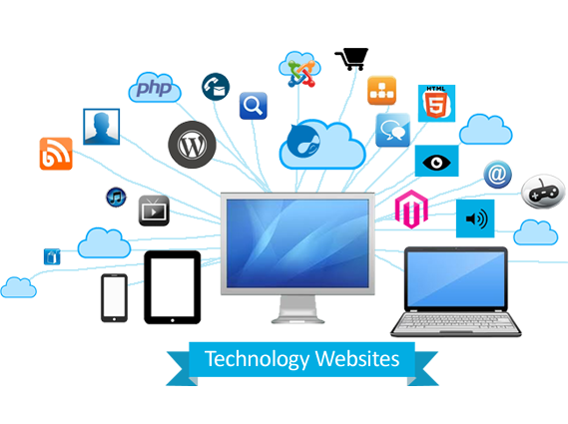
What is Website Technology?
Website technology encompasses the tools, programming languages, frameworks, and protocols used to create, manage, and maintain websites.
It involves both the front-end (client-side) and back-end (server-side) technologies that work together to deliver a seamless web experience.

Slide 4
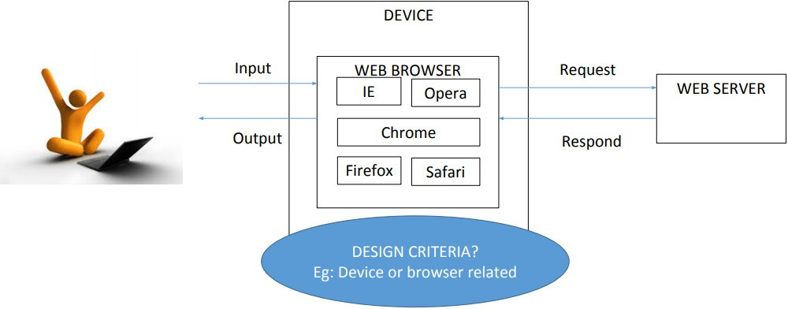
How People Access the Web

Slide 5
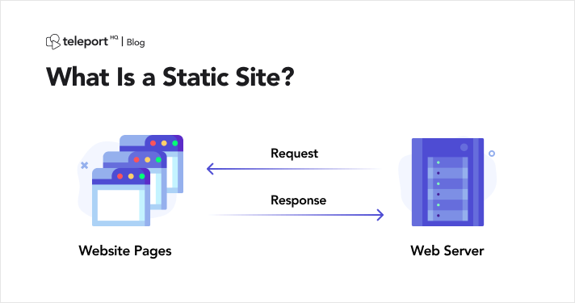
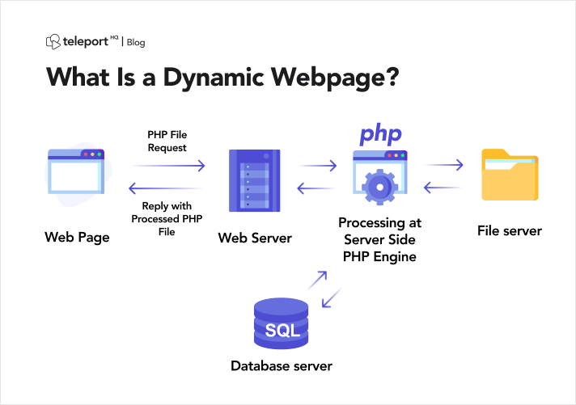
Static Website
Dynamic Website
Static websites are built with fixed content that doesn’t change unless manually updated. It never uses database.
Personal blogs, small business websites, portfolios
Dynamic website generate and update content in real-time based on user interactions or inputs from database (to store, retrieve information).
Include interaction features like forms, dashboard or search function.

Slide 6
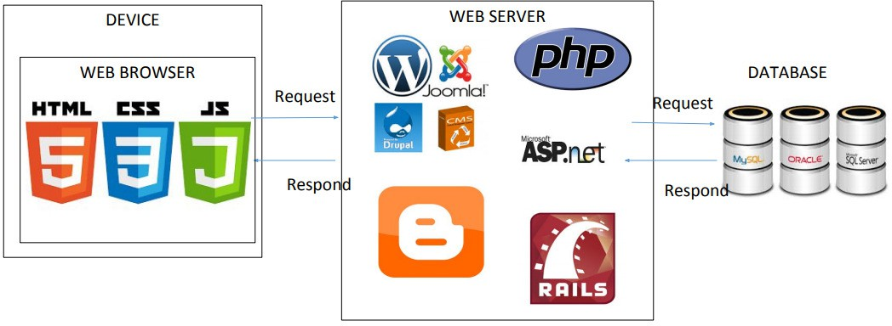
How Websites are Created

Slide 7

What is client-Server Model and Web Servers
The Client-Server Model
The client-server model is a way to structure communication between the client and server.
Client: A client is a device or application typically a web browser that requests services or resources from a server. The client sends requests to the server and displays the server’s responses to the user.
Server: A server is a powerful computer or software system that provides services, resources, or data to clients. It listens for incoming requests from clients, processes them, and sends back the appropriate responses.
The Role of Web Servers
A web server is a specific type of server that hosts web pages and serves them to clients (web browsers) over the internet. Web servers handle HTTP requests from clients and return HTTP responses along with web page content.

Slide 8
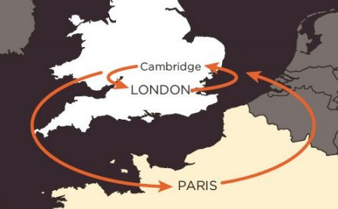
How The Web Works
When a web user in England wants to view the website of the Louvre art gallery in France which is located at www.louvre.fr.:
The browser in Cambridge contacts a DNS server in London.
The DNS server then tells the browser the location of the web server hosting the site in Paris.

Slide 9
Q & A

Slide 10
ICTF 0554 Web Technologies
HTML - Introduction to HTML
Part 2
Department of Information and Communications Technology, , IIUM

Slide 11
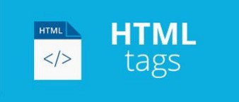
Contents
What will your website look like
Dealing with files
HTML basics
Metadata in HTML

Slide 12
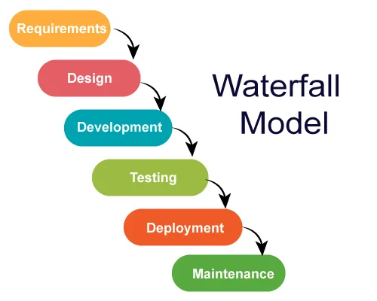
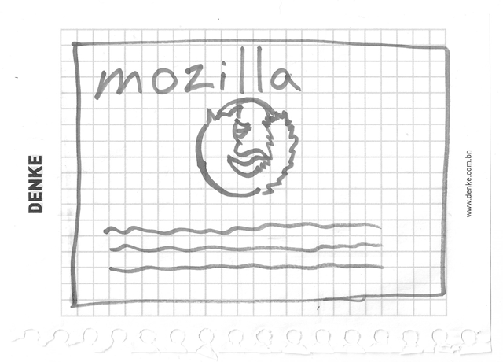
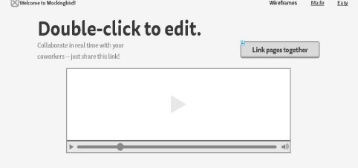
Web Development
Planning
Software Development Life Cycle
What is the content of your website?
Who is your target audience?
UI Sketch
Simple hand-drawn or digital focusing on the design of user interface elements.
Choose your assets and style
Choose your text, color, images, fonts

Slide 13
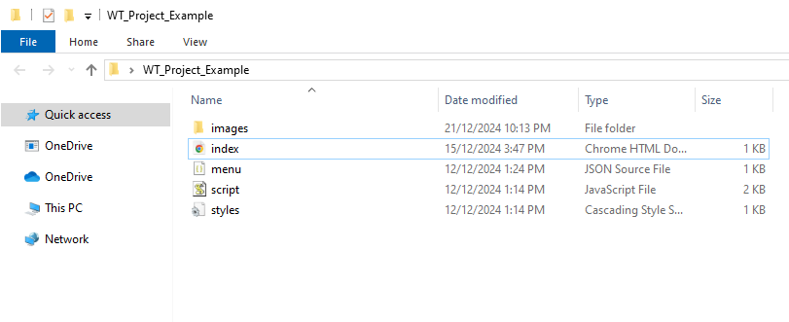
Project folder & files
index.html
images folder
CSS files/folder
JavaScript files/folder

Slide 14
Hypertext Markup Language (HTML)
HTML is NOT a programming language. It is a markup language used to structure and present content on the web.
It does not have logic or conditional statements.
HTML Character set use UTF-8, ASCII, ANSI, Windows-1252, etc.
HTML markup includes special "elements" such as <head>, <title>,
<body>, <header>, <footer>, <section>, <p>, <div>, <span>, <img>, <audio>, <embed>, <nav>, <video>, <ul>, <ol>, <li> and many others.

Slide 15
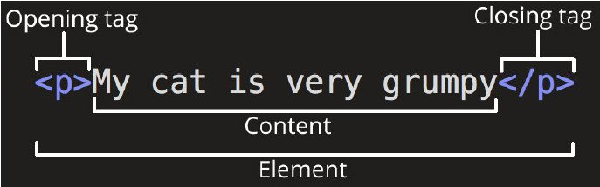
HTML Elements
HTML elements is everything from start tags, content, and an end tag which consist of the element name surrounded by < and >
Source: https://www.w3schools.com/html/html_elements.asp

Slide 16
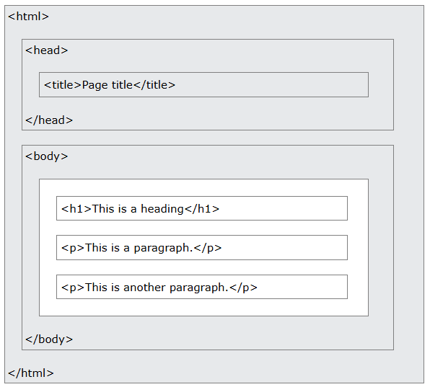
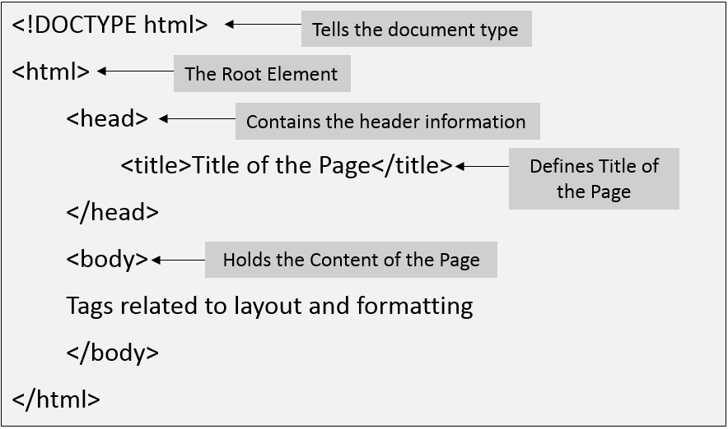


HTML Structure
You can use the short form in creating the structure of HTML
in VS Code by pressing exclamation mark (!) + ENTER

Slide 17
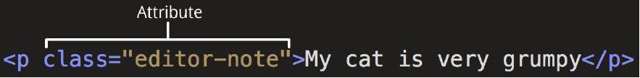


Attributes, Nesting and Empty Elements
Elements with attributes
Nesting elements
Images (Empty elements)

Slide 18
Example HTML Attributes
All HTML element can have attributes. Example like src, href, width, height, alt, style etc.
<a href="https://www.w3schools.com">Visit W3Schools</a>
<p style="color:red;">This is a red paragraph.</p>
<img src="img_girl.jpg" width="500" height="600" alt="Girl with a jacket">

Slide 19
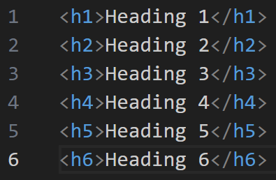
Heading
Heading use to display titles or subtitles on webpages.
<h1> defines the most important heading, <h6> defines the least important

Slide 20
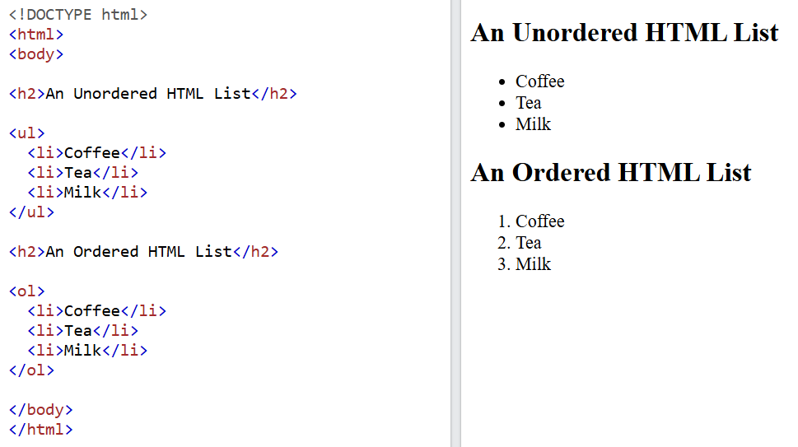
HTML List
HTML List
- Unordered Lists: <ul> represent an unordered list in bulleted.
- Ordered Lists: <ol> an ordered list in numerical or alphabetical.

Slide 21
Comments in HTML https://www.w3schools.com/html/html_comments.asp
In HTML, comments are used to leave noted or explanations in the code. Comments are not displayed in the browser:
Comments can be used to hide parts in the middle of the HTML code.
<!-- comments -->
<p>This <!-- great text --> is a paragraph.</p>

Slide 22
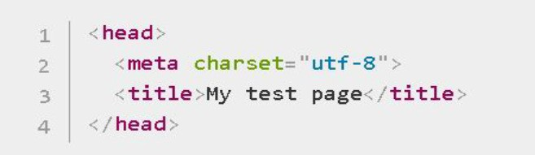



Metadata
Metadata use to provide information about the webpage that’s is not displayed directly on the page itself.
Use of Metadata:
Specifying character encoding
webpage is responsive to different screen size
Defining content ownership

Slide 23
Lab Practical

Slide 24
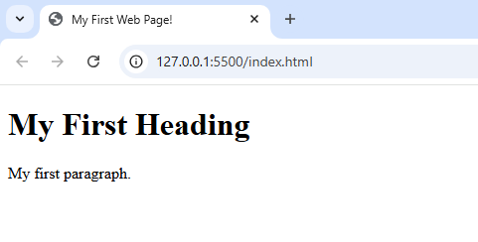
Class Activity 1
Try to write the code based on the picture above by using the right elements.

Slide 25
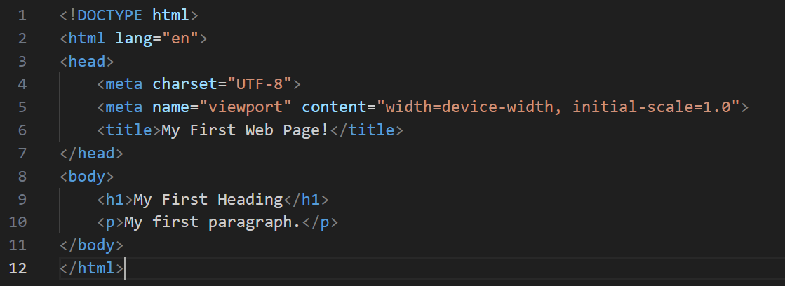
<!DOCTYPE html>
<html lang="en">
<head>
<meta charset="UTF-8">
<meta name="viewport" content="width=device-width, initial-scale=1.0">
<title>My First Web Page!</title>
</head>
<body>
<h1>My First Heading</h1>
<p>My first paragraph.</p>
</body>
</html>

Slide 26
Class Activity 2
Visit W3Schools HTML Links Tutorial page and write and test the markup language for elements below:
HTML Attributes
HTML Links
HTML List (Unordered Lists & Ordered Lists)

Slide 27
Thank you!

